Slide 1
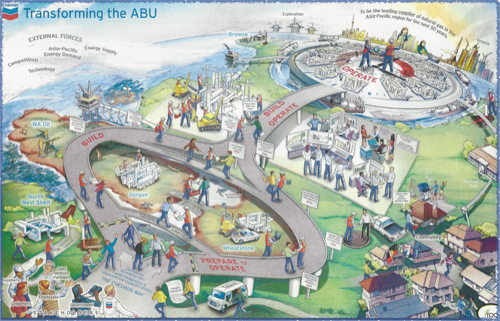


LEARNING MAP INTERPRETATION
OYSTER CATCHER
UNIT 6

Slide 2
The CHEVRON Learning Map is just like the CoRE Learning Map, it shows the paths taken and the different skills learnt, developed and intergraded in your work, in order to complete your journey successfully. As we work with the community, native land owners. So that you will be equip for the workforce awaiting you.

Slide 3

In the begin of the CHEVRON Learning Map, it shows the Stakeholders. These are the Government, Engineers, Customers, Suppliers and Joint Venture Partners who show their interest in the business and invest in it, believing that the business will prosper. The stakeholders are affected by every move the business makes, either bad or good, it all weighs on the stakeholders. This agreement between the stakeholders and the business is long-lasting and is seen beneficial in the long run.
As new recruits of Kent Street Petroleum (KSP), we start our learning journey with a shortage of skills. In our context, the Government, Suppliers, Engineers, Customers and Joint Venture Partners represent the different people and organisations we associate with in the beginning like teachers and peers. We develop trusting relationships and new partnerships during the first few weeks of interaction. Then with a steady footing, we indulge ourselves into the KSP workforce and we officially begin this expedition.

Slide 4
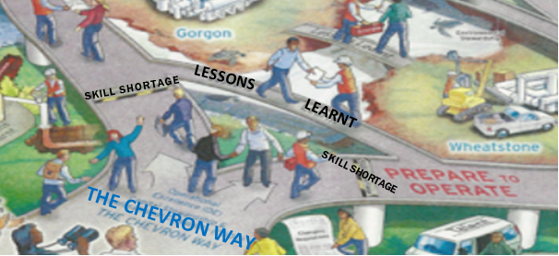
CSOC / OE
The next step of the journey, is getting started with ‘THE CHEVRON WAY’ learning approach. This process is the Capital Stewardship and Organizational Capability (CSOC) and Operational Excellence (OE) meaning that your are now responsible for your education and learning. The outcome from here on, is dependant on how committed and determined you are to achieve your goals and aspirations. This is the stage where you embark on your voyage of a lifetime. Advancing past your shortage of skills and onto new pastures where you are now preparing yourself to operate and learn valuable lessons throughout the way.
In KSP terms, you will not be ‘spoon-fed’ by your teachers. Taking and acting on your responsibilities mean that you will be disciplined and not need a push-start to direct you onto the correct path. Simple responsibilities like the weekly Performance Management (PM) or joining the Duke of Edinburgh Program showing your leadership in your education. This learning process is advantageous in the now challenging and demanding workforce of this modern century .And so absorbing skills such as the COSC an OE scheme, will help you conquer the working fields of today as you attain more and more soft skills each day in THE CHEVRON WAY. This is also known as Preparing Yourself To Operate.

Slide 5
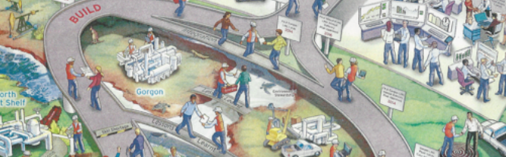
GORGON
LESSONS LEARNT
WHEATSTONE
This is the highlight of the journey, here is where the construction and building take place. Mining sites are drawn in the middle of the bridge representing Gorgon and Wheatstone , both are well flourishing Mining Businesses started up by CHEVRON. And connecting each isolated mining site is a bridge that says ‘Lessons Learnt’. As I have stated before, learning will never stop ,it continues on with you as you excel further into the journey. The Project Based Learning (PBL) way of understanding is presented at this stage, you will be given several projects to complete as you link together all subjects. Doing this will allow you the opportunity to use your newly improved soft skills and display your commitment and discipline.
At this, all the real work happens. This is the stage where you will undertake your PBL assessment while working in the different divided ‘Business Units’ of KSP. These units are separately named in honour of the native creatures of Barrow Island where all the data/information we use in class are collected from. These units are to last throughout the year, to move people out of their comfort zones replicating a real life working environment.

Slide 6
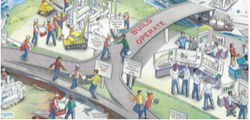
INTEGRATE
Now nearing the end of the journey, you will need to integrate all that you have learnt throughout the course of the expedition. Collecting the data and showcasing your completed work will require you to use soft skills. Time and effort must be used efficiently through this period. As you come to a conclusion, summary and finally to an end of this project, you will be asked to reflect on the trial in order identify the key points learnt to take with you to the next step of the journey.
In KSP we call this stage the ‘Town Hall’. The Town Hall is held at the end of the term to spectacle our separate business units outcome of the PBL given prior. It is another form of using your soft skills by striking confidence into you. Your teacher will asses you and then mark you based on the outcome of your PBL. Unlike the Learning Map where the presentation stage occurs only once, this Town Hall happens at the end of every PBL. Meaning that in one year, four PBL’s are assigned followed by a town hall each term.

Slide 7
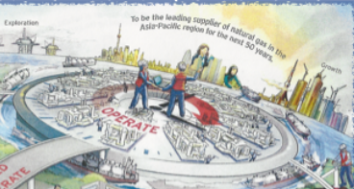
EXPLORATION
To be the leading supplier of natural gas in the Asia-Pacific region for the next 50 years.
GROWTH
We have reached the end of the map, which is the Operating stage. But this doesn’t mean that we draw the line here, it means that we have opened more doors for ourselves to venture into. Now that you are exposed into the work force you can apply all the attained soft skills, techniques and aptitudes in the field of your choice. Regardless weather or not it is related to the Mining Industry – even thought CHEVRON is mining based. With the sea of knowledge you have obtained from The CHEVRON Way learning approach, you will be able to conduct and manage explorations or onslaught a growth expedition for your employer. Or even better, build your own company.
In KSP, this stage is accomplished as we conclude the year. We can then be able to proceed through the following years of High School with the skills obtained from this learning process. Or also in the different opportunities that emerge throughout the year such as Conventions, Meetings or any social event outside of the school. In such events, we are given the opportunity to use our networking skills with important personnel's. But ultimately, all these process, skills and techniques are very profitable for our future path ways.

Slide 8

Other than displaying the CHEVRON learning process, this map also shows the different organisations and groups that CHEVRON works hand-in-hand with. For example; the Community around us, The Indigenous People of Australia as we acknowledge that they are the land owners of the land in which we are located and The numerous WA Oil companies with the different LNG sites. Other businesses' are the shipping business, Exploration businesses , Construction businesses and the Human Energy involved.
CHEVRON responds to the External Forces, such as Demand, Energy Supply, Competition and Technology and the Commodity Market of LNG. By doing this, CHEVRON is leading in the Asia-Pacific region as suppliers of LNG .

Slide 9
THANK YOU
FOR YOUR TIME

Slide 10
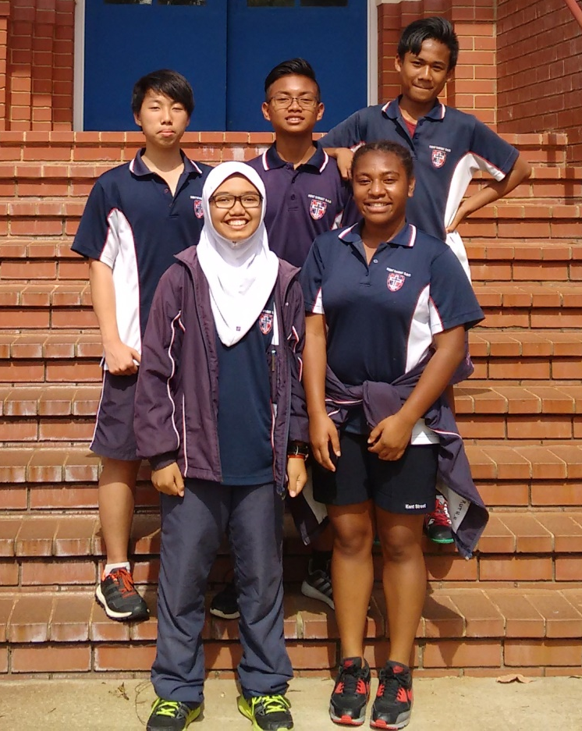
OYSTER CATCHER :Business Unit 6
Kevin. Tanjaya, Sheva. Zain, Theddy. Langsa
Zahra Nur Salsabila , Ruth Henry

Slide 11
Bibliography:
http://www.businessdictionary.com/definition/stakeholder.html

